Slide 2
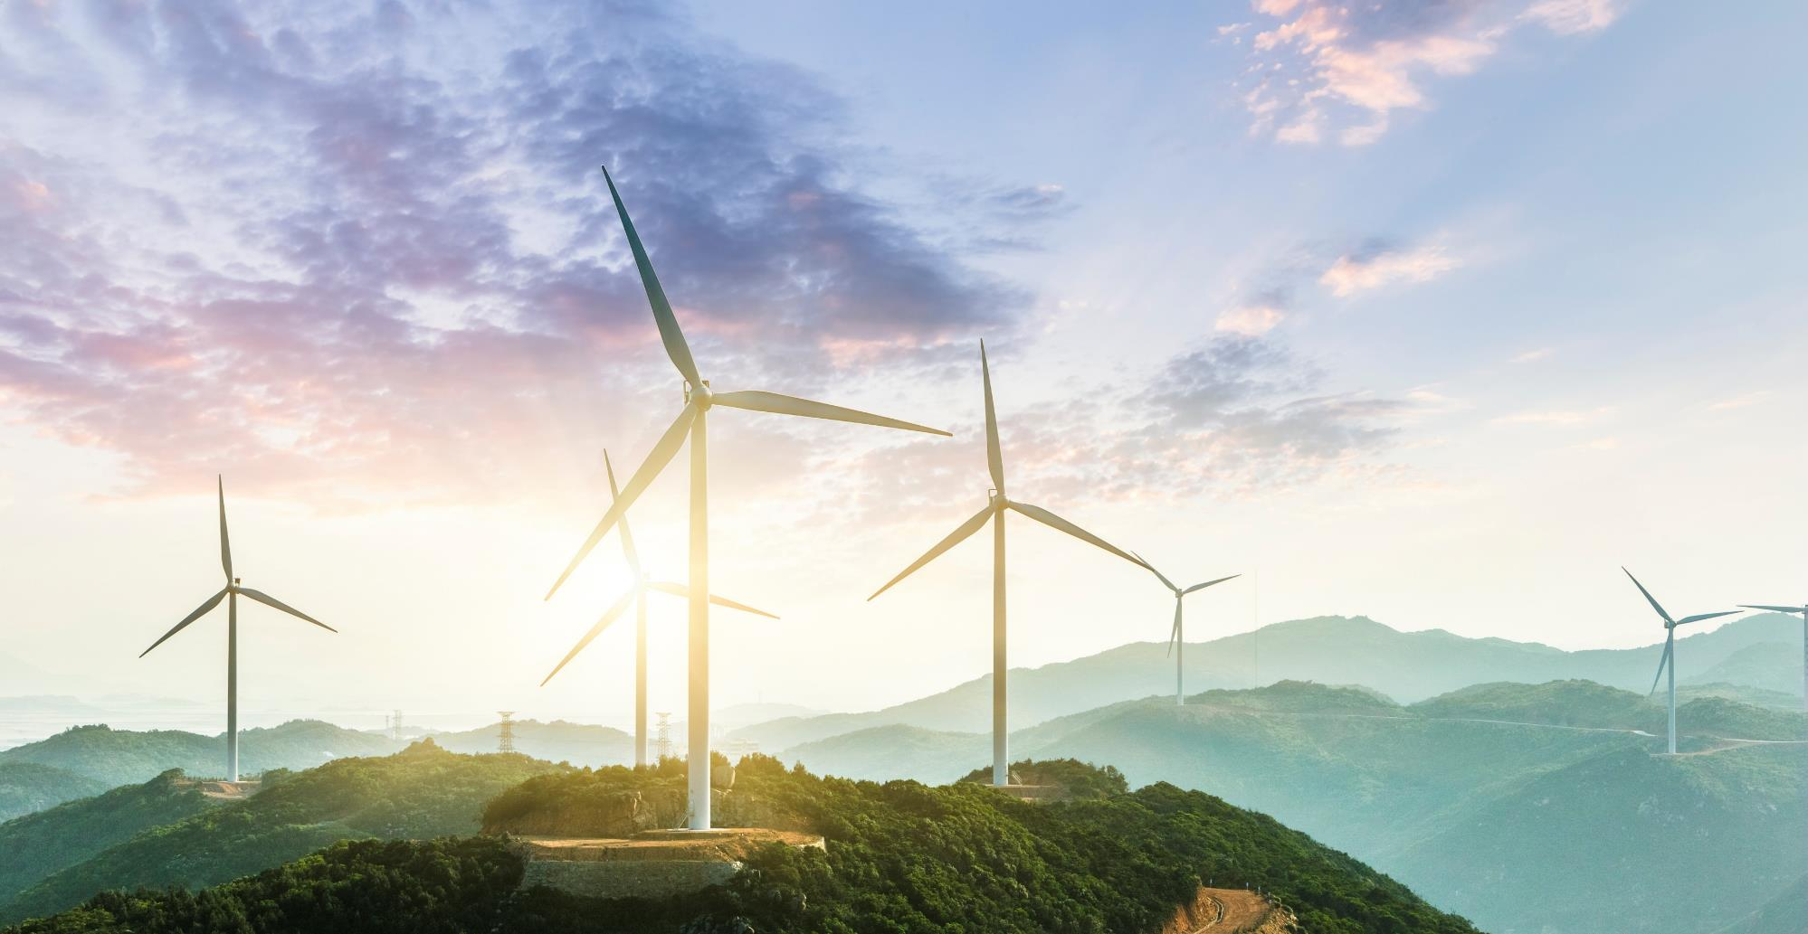
Condition Monitoring of Wind Turbines
Selected Vibration Analysis Case Studies

Slide 3
Condition Monitoring of Wind Turbines
Contents
Description of a Wind Turbine
Rationale for Installed Systems – Cost Benefit Analysis
Typical P-F Curve for Wind turbine Faults
Case Studies
  Blades
  Main Bearing
  Gearbox
  High Speed Bearing
  Structural Health
Conclusions

Slide 4
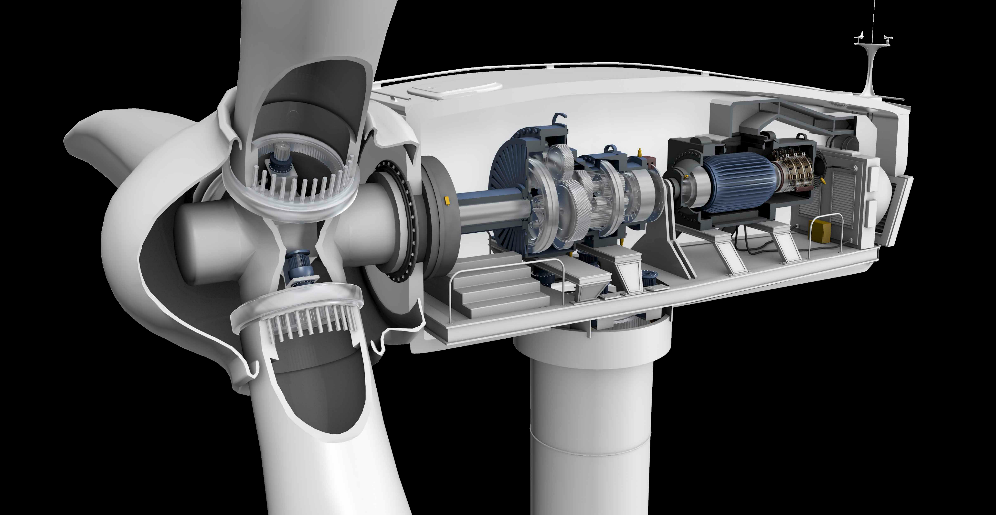
Description of a Wind Turbine
Blades
Main Bearing
Planetary Gearbox
Helical Stage Gearbox
LSS bearing
HSS Bearing
Coupling
Generator
Tower
3
4
6
7
2
8
5
9
1
Notes:
Needs a better graphic
Currently set same as existing, Would like a better set…
See slide 12

Slide 5
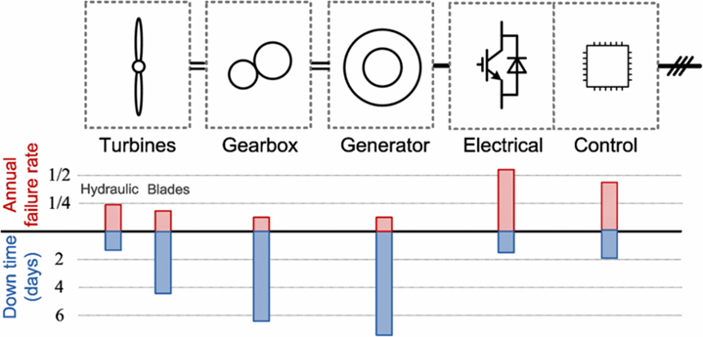
Cost Benefit Analysis
Statistical failure rate vs. downtime rate
Maintenance strategies:
Reliability oriented vs. Condition based
Electrical components may show a higher failure rate but cause usually little downtimes only
Failures on the mechanical components of the drive train usually cause higher downtimes per failure
Forewarning provides more planning time and allows maintenance to be optimised
Source: Fraunhofer Institute for Wind Energy Systems (IWES)

Slide 6
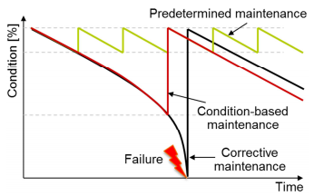
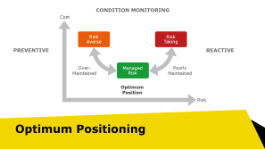

Cost Benefit Analysis
Predictive (Condition Based) Maintenance
Benefits compared to Preventive Maintenance
Uses full life of parts – no replacement of healthy components
Reduced maintenance requirements
Reduced risk of maintenance induced failure
Fewer replacement parts
Benefits compared to Reactive Maintenance
Reduced downtime through planning
Reduced lost time due to weather
Parts ordered at right time, not kept on stock
Repair cheaper than replacement
Refurbishment of large items usually possible
No consequential damage
Fraunhofer IWES, „Condition Monitoring of Wind Turbines“ 2015

Slide 7
CONDITION MONITORING
Cost
Risk
Averse
Risk
Taking
PREVENTIVE
REACTIVE
Over-
Maintained
Managed Risk
Poorly
Maintained
Optimum Position
Risk
Optimum Positioning
Notes:
Maintenance strategy should be based on knowledge of your equipment and how it might fail.
Waiting for a failure leads to breakdowns at an inconvenient time and large consequential damage – either physical or financial
Maintaining everything whether it needs it or not is often seen as risk averse, but can lead to high costs and high levels of maintenance induced failure due to higher amounts of work required during outages.
Condition Based Maintenance focuses on the equipment that needs maintenance, but how sure are you about the results? Can the monitoring detect every failure? These questions are at the heart of a knowledege based maintenance strategy.

Slide 8
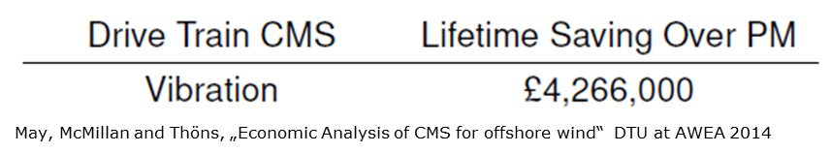
Cost Benefit Analysis
Theory
Analyse all possible failure modes
In each case calculate cost of:
  undetected failure
  routine replacement
  planned replacement due to CM
Considering
  Probability of failure
  Probability of detection
  Probability of maintenance induced failure
Aggregate across farm
Subtract monitoring costs
(opex + capex)
Savings depend on assumptions
Most companies reluctant to share values
Academic studies suggest payback in between 1 and 3 years
Case studies from wind industry agree with this range

Slide 9
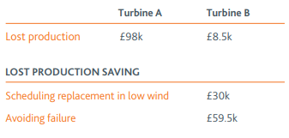
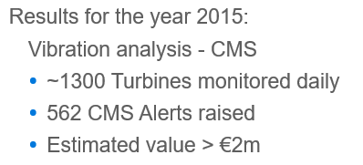
Cost Benefit Analysis
Practise
Individual savings can be spectacular, but don‘t just take our word for it.
Sometimes system manufacturers overstate the benefits
Operators and manufacturers don‘t like to talk about the actual savings - commercial considerations (cost of downtime and cost of spares can be calculated)
Exact figures are hard to come by, but
  Several OEMs have adopted CMS as standard
  Several service organisations fit CMS as standard
  Several operators now insist on CMS being fitted
  Do you think it is worth it?
RES Website Case Study
Uniper Presentation at VGB Wind Turbine Conference, Hamburg 2016 (Ingenabel and Futter)

Slide 10
Wind Turbine Component failure modes
Typical PF Curve
Typical PF curve for a rolling element bearing
Vibration (especially envelope) gives good lead time
Wear debris and thermograpy also effective
Temperature rise normally too late.
Note. PF curves are qualitative!

Slide 11
Case Studies
Unbalance
Main Bearing
Planetary Gearbox
HSS Bearing
Structural Health
2
3
4
5
1
Notes:
Needs a better graphic
Currently set same as existing, Would like a better set…
See slide 12

Slide 12
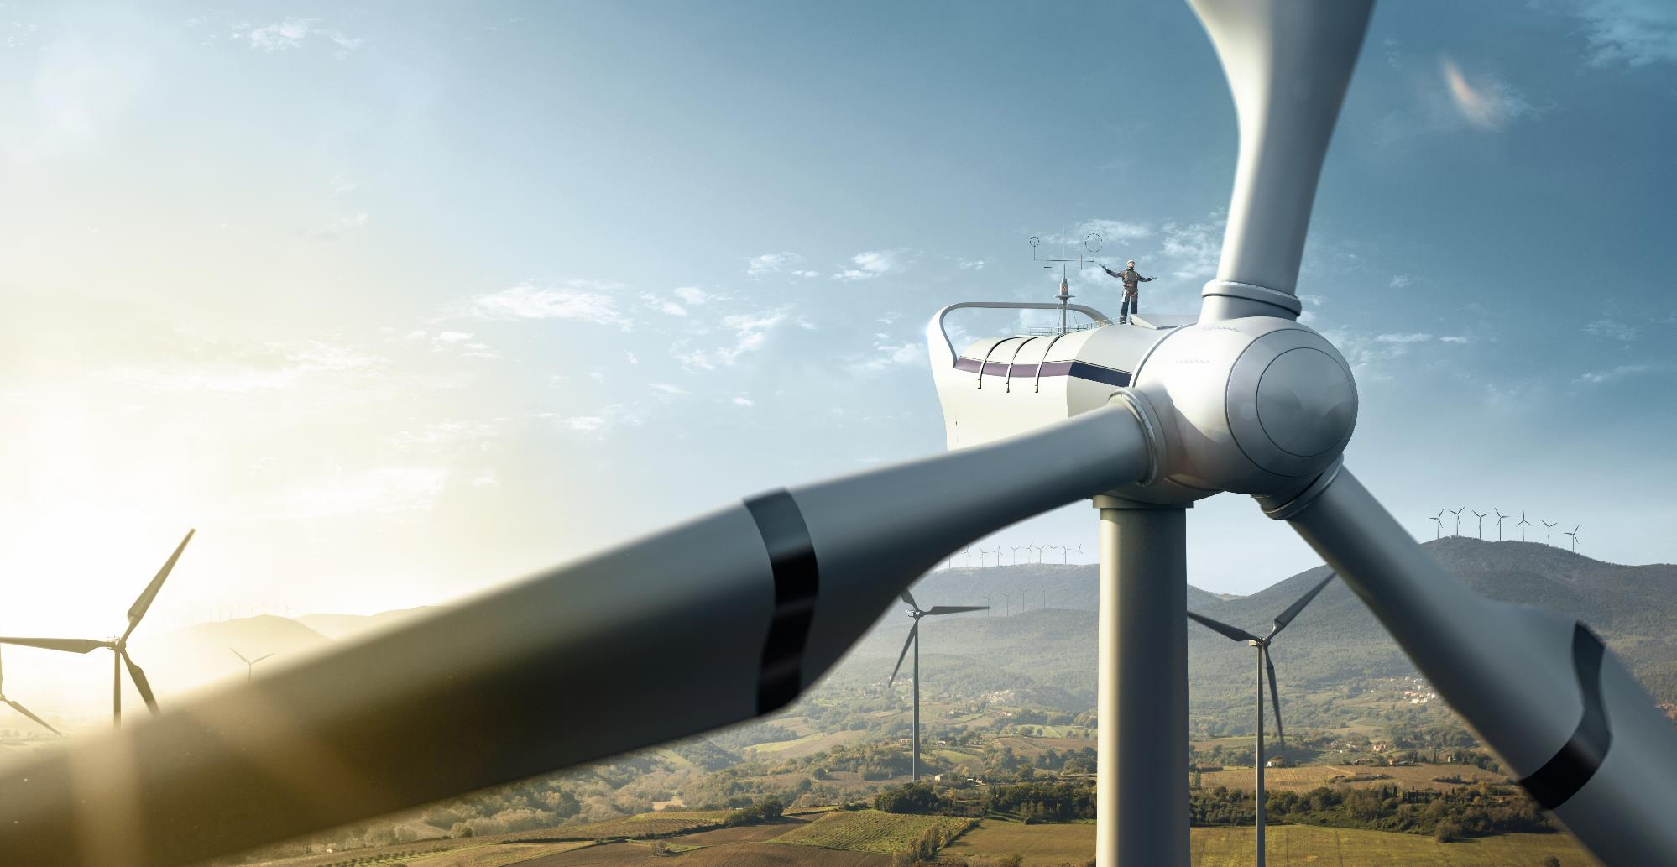
Blade unbalance
Case Study 1

Slide 13
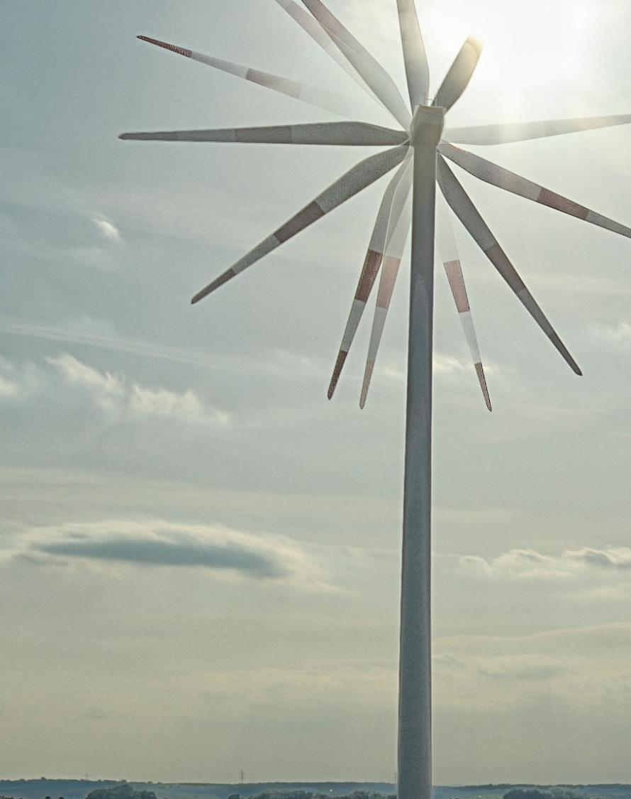
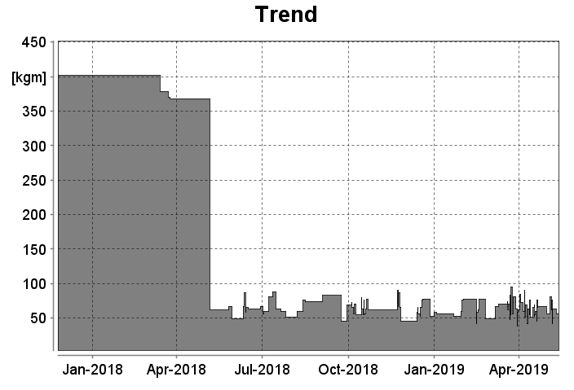
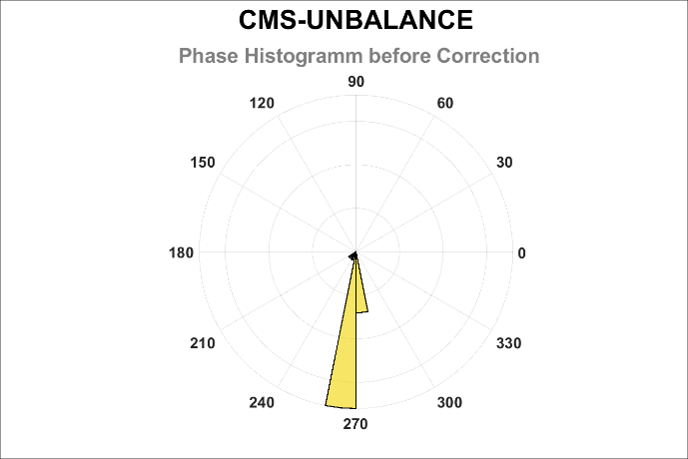
Case Study 1: Blade unbalance
380 kgm
52 kgm
CMSUNB: Histogram of Phase before correction
CMS-Unbalance Plugin
Mass Unbalance | 380 kgm
Phase | 275°
On-site measurement (test weights)
Mass Unbalance | 375 kgm
Phase | 272°
www.bachmann.info

Slide 14
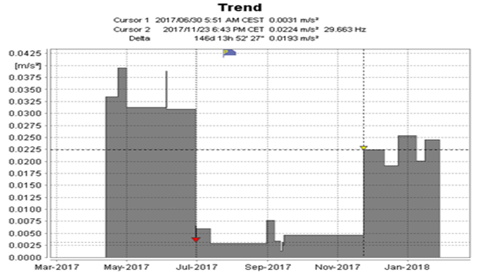
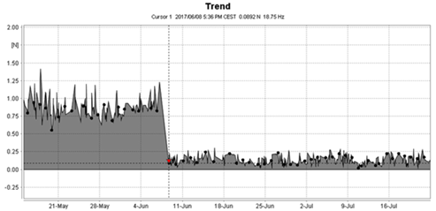
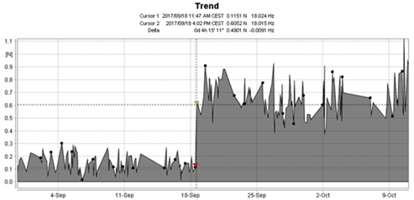
Case Study 1: Blade unbalance (Aerodynamic)
All aerodynamic unbalances corrected
Ongoing trial of mass unbalance system
Aerodynamic unbalance re-appeared after a few months
Customer requested more exact time for change
We identified a 6 hour window
Technician on site applying loctite to pitch system
Rapid warning provided
Reduced loss of earnings
To quote the customer: „Das System rockt!“
EN: “The system rocks!“
www.bachmann.info

Slide 15
Main Bearing Defect
Case Study 2

Slide 16


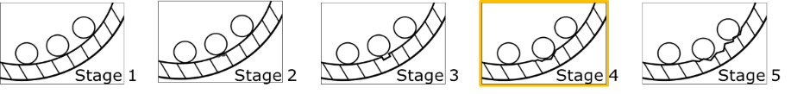
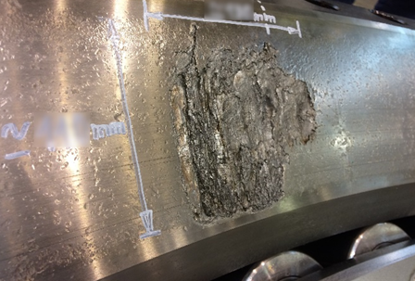
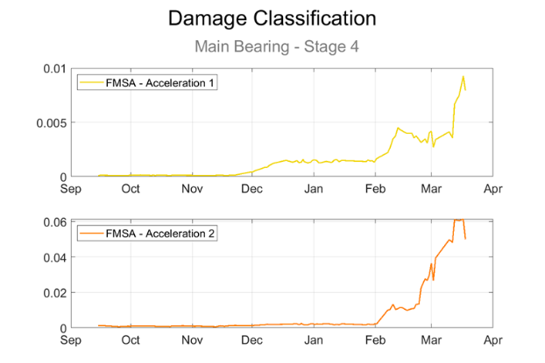
Case Study 2: Main Bearing Defect
Early detection of bearing frequency
Tracking through development of damage
Allows intervention at most appropriate time

Slide 17
Planetary Stage
Tooth Damage
Case Study 3

Slide 18
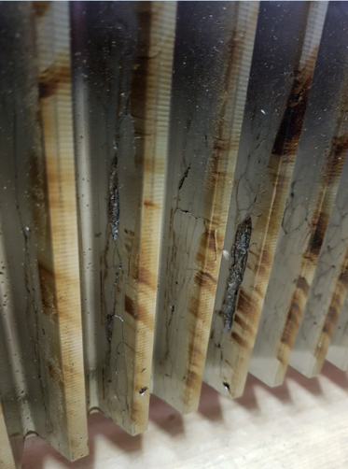
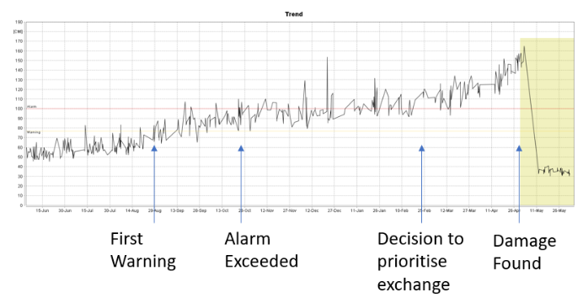

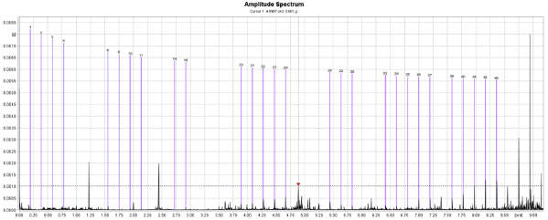
Case Study 3: Planetary Stage Tooth Damage
Gear type known to be susceptible to failure
First warning 29 Aug 2017
Endoscope found no faults
Trends continued
Ring gear replacement prioritised
Exchange carried out April 2018
Damage found shows
exchange saved the gearbox.

Slide 19
HSS Inner
Ring Defect
Case Study 4

Slide 20
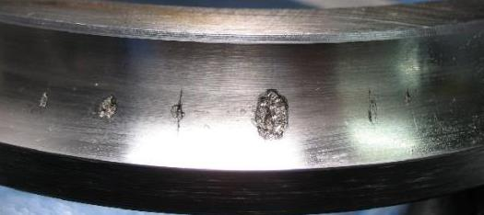
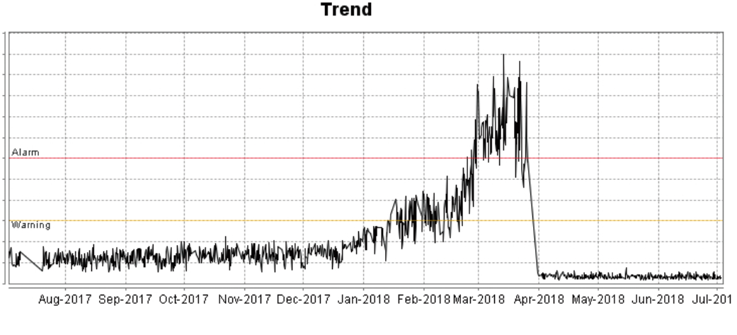
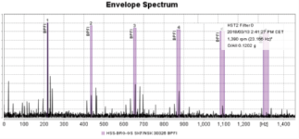

Case Study 4: HSS Inner Ring Defect
A HSS defect was noted
Damage initiation possibly present when monitoring began
First indication after the warning level was exceeded in February 2018
Allowed the customer to plan a repair
Graphic from relevant analysis here
Reminder
Intervention at ideal time
Damage beginning to trend, but at this point minimal consequential damage
Advance warning meant that the teams were ready to make the exchange with minimal loss of production when the damage began to increase
Repair
First Warning

Slide 21
Structural
Health
Monitoring
Case Study 5

Slide 22
Case Study 5: Structural Health Monitoring
Control systems designed to avoid the tower eigenfrequency
Excitation at 1/rev and at Blade Pass (3/rev) frequencies
Need to redefine control speeds, if the as-built eigenfrequency is too far from the design eigenfrequency

Slide 23
Case Study 5: Structural Health Monitoring
Vibration analysis of Signals from MEMS Sensors in the tower
Natural Frequency Extracted from the Signal
  Low natural frequency due to loss of stiffness, e.g. scour
  High natural frequency due to underestimation of soil strength
Example here shows EF almost 10% above design

Slide 24
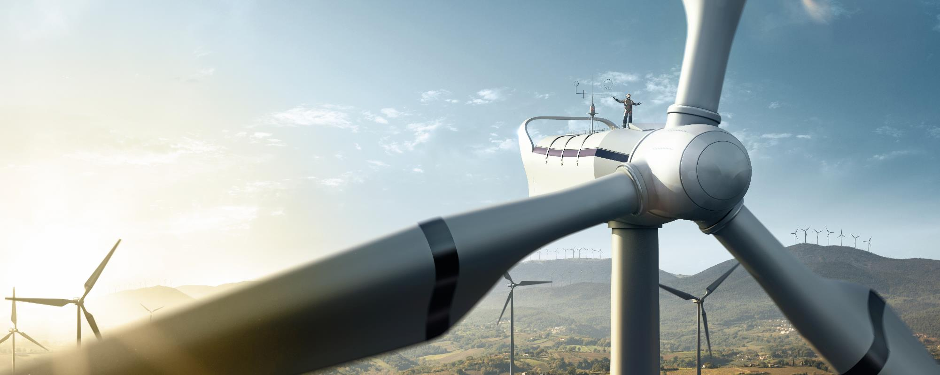
Conclusions
Condition Monitoring for Wind Turbines
Clear cost-benefit for fitting monitoring systems to wind turbines
Vibration analysis a very useful tool
Numerous case studies show success of the method
Fault severity tracking being introduced
Extra information being extracted
  Blade Balance Quality
  Structural Health

